Slide 1
Restaurant Venues Clustering in Chennai City using Foursquare & Population data
By
Prabhakaran Elangovan

Slide 2
Problem Statement
The objective of the project is to harness the power of data & Data Science and to derive insights about various locations.
Aims to reduce the burden of entrepreneurs to make better and profitable decisions while finalizing the venue to invest.
To segment various locations in chennai by using Machine Learning model with location-wise population and venue data.

Slide 3
Data Sources
Population data – Primary Census Abstract (PCA) data released by Government of India partnered with the Chennai Metro Corporation department.
Data Source: http://censusindia.gov.in/pca/pcadata/Houselisting-housing-TM.html
Venue master list – Venue list for each area in Chennai as available in Foursquare application.
Additionally geocoder python library is used to fetch location coordinates

Slide 4
Methodology
Clustering – Unsupervised learning algorithm is used to segment the various locations.
Obtain location coordinates using geocoder and join that with the existing population dataframe.
Locations containing duplicate values are handled by grouping the data and passing aggregate functions to each column, separately.
Use Foursquare API to get venue details for each locations, duplicate venues are found and removed by concatenating venue and latitude values.
Venue category is converted to numeric values by using one-hot encoding.

Slide 5
Methodology
Dataframe is grouped at Location level and the column values are summed up.
The population and venue is merged together and relevant features are selected.
The feature values are converted to feature matrix.
The feature matrix is standardized by using StandardScaler.
The feature matrix is then passed to k-Means algorithm to obtain clusters.
K value is initialized to 3.

Slide 6
EDA
Total number of Venue categories available in Chennai as per Foursquare is 171.
The data is filtered such that it contains only ‘Restaurant’ related venue categories like any value containing restaurant in it or BBQ Joint or other similar categories. It is found that the city contains 418 such joints belonging to 71 different types of restaurants..

Slide 7
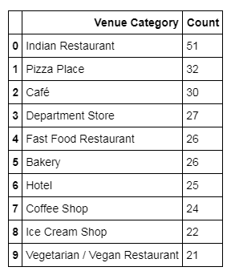
Top 10 Venue Categories

Slide 8
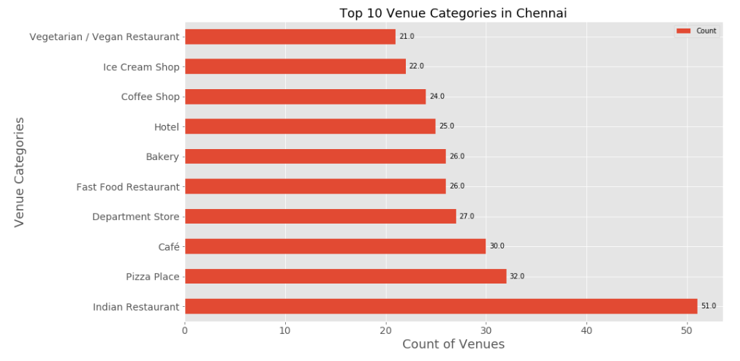
Top 10 Venue Categories - hbar

Slide 9
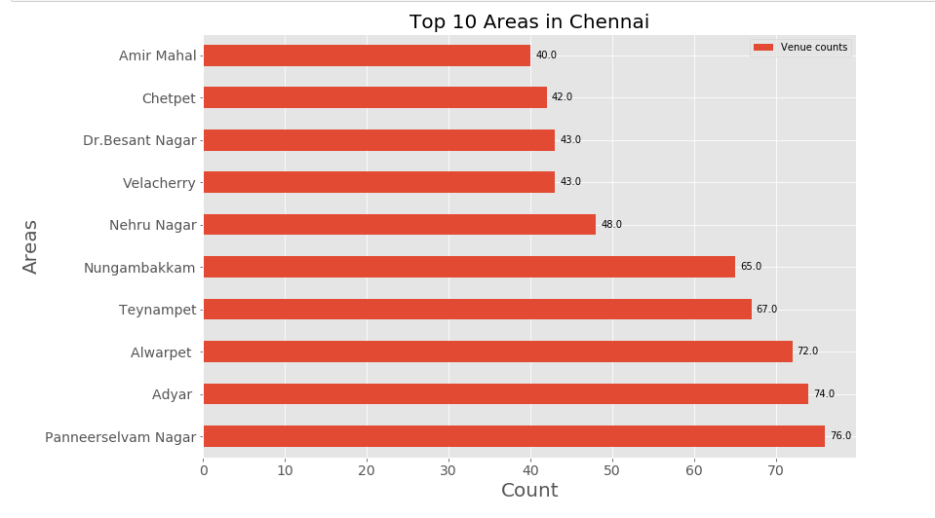
Top 10 locations with most venues

Slide 10
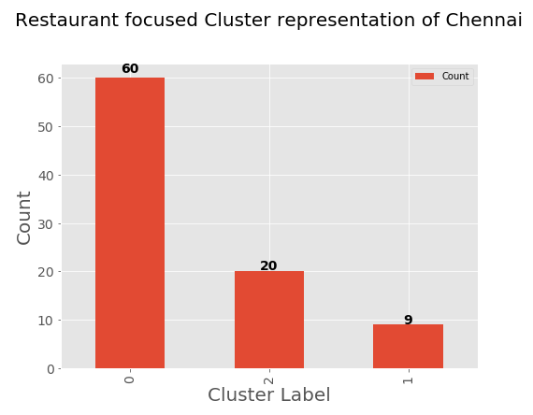
Modeling - Results
The cluster segmentation chart is shown below.

Slide 11
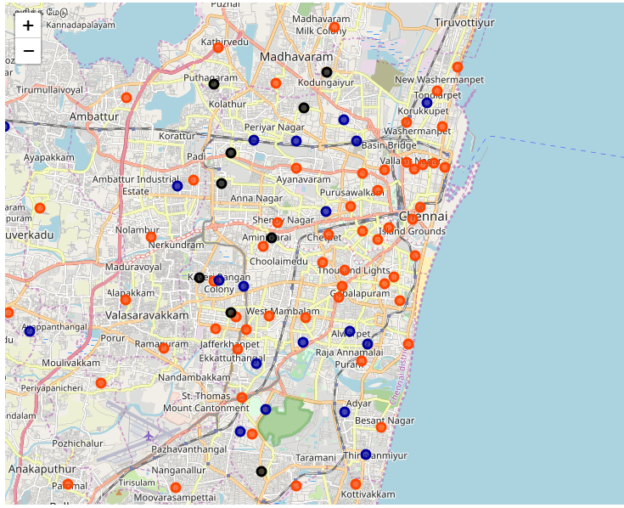
Clusters – Folium Map

Slide 12
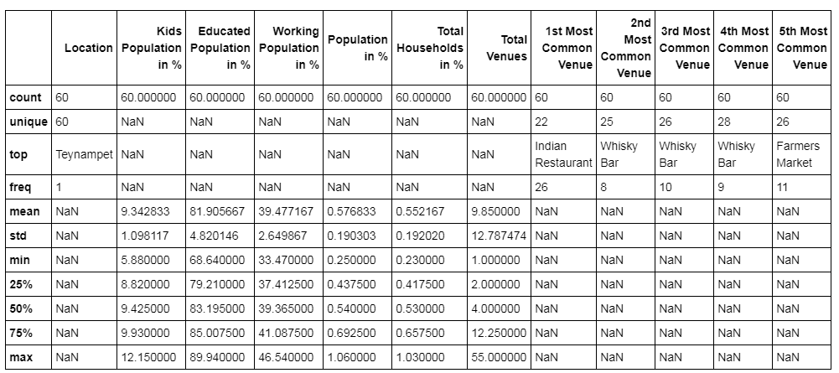
Cluster 1 - Descriptive

Slide 13
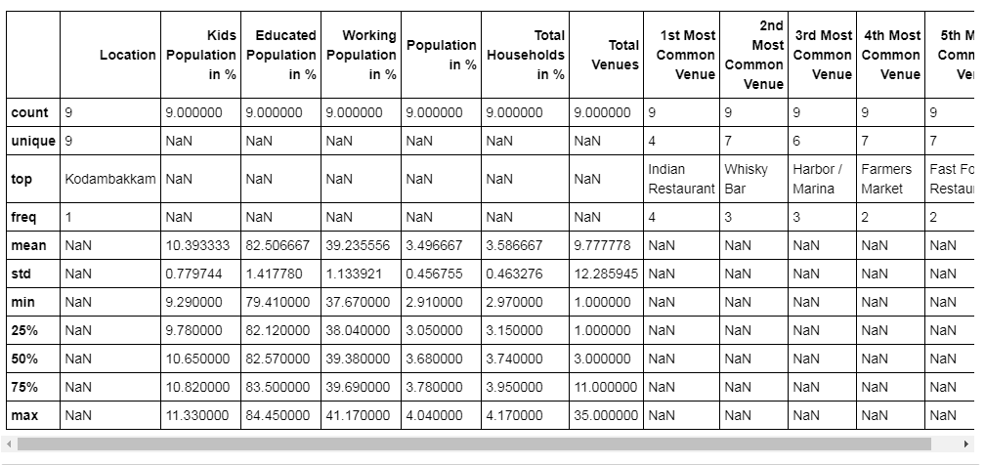
Cluster 2 - Descriptive

Slide 14
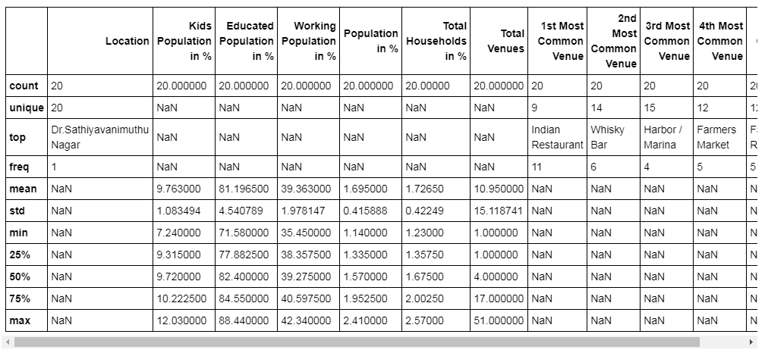
Cluster 3 - Descriptive

Slide 15
Cluster - Findings
Cluster 1 – Dense cluster, sparsely populated areas, high education population.
Cluster 2 – Sparse cluster, densely populated areas, high kids population.
Cluster 3 – Moderately dense cluster, moderately populated, high education population.

Slide 16
Thank You

